Slide 1
Flip Ebook App

Slide 2
Introduction
Flip is the ultimate eBook app for all readers, offering a vast library that includes fiction, non-fiction, self-help, and academic texts. It features a user-friendly interface, customizable reading options like dark mode, and bookmarking. You can look up words, highlight text, and make notes. Flip also syncs your reading progress across multiple devices, ensuring a seamless experience wherever you go. Regular updates bring you the latest bestsellers and timeless classics. Discover your next favorite book with Flip today!

Slide 3
Software Requirements Specifications
Project Description
Flip is an e-book app offering user authentication, genre-based browsing, detailed book descriptions, bookmarking, text-to-speech, and a community forum. It supports both light and dark modes for an enhanced user experience.
Problem Statement
With e-books rising popularity, there is a need for an app that combines reading with community engagement and seamless access across devices. Flip addresses this by offering a user-friendly interface, robust community features, and integration with Firebase for authentication and data management.

Slide 4
System Requirements
Functional Requirements
1. User Authentication : Signup or SignIn using Email / Google with Opt Verification
2.Genre Selection: Users Can select from different genres in the app
3.Book Browsing and Interaction: Users can read the brief description of the book and also read the whole book , Bookmark it , Text to Speech for easy reading
4.Built in Community : For User interaction purposes
5.User Interface: App supports both Dark and Light Mode

Slide 5
System Requirements
Non-Functional Requirements
1. Performance: Fast loading times for product pages and checkout processes
2.Security: Compliance with data protection regulations (Firebase Encrytion)
3.Scalability: Elastic scaling to adjust resources based on demand
4.Compatibility: Suppports major Operating Systems

Slide 6
System Requirements
Domain Requirements
1. Payment Gateway Integration: Integration with secure payment gateways like PayPal to facilitate transactions.
•
2. E-Book Management:
• Real-time inventory tracking to ensure accurate product availability.
•
3. Customer Support: Integration of customer support features such as help desk, FAQs, and contact
4. Community promotions:
• Support for discount codes, promotional offers, and loyalty programs.
•

Slide 7

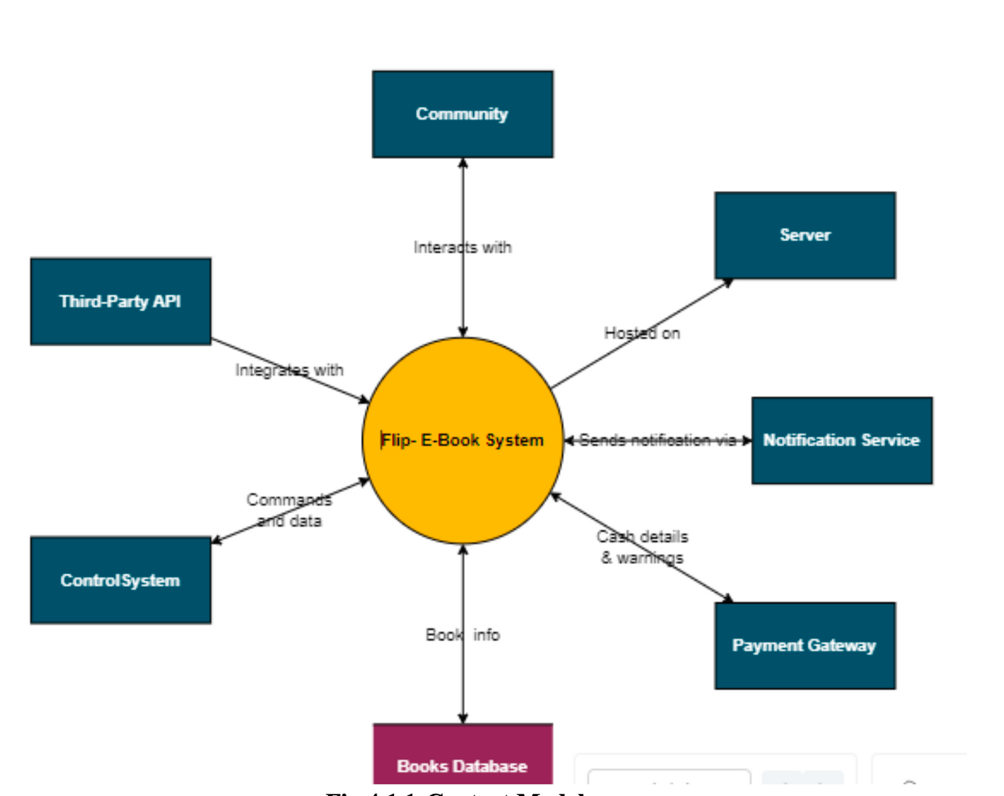
ARCHITECTURAL DESIGN
Context Model

Slide 8
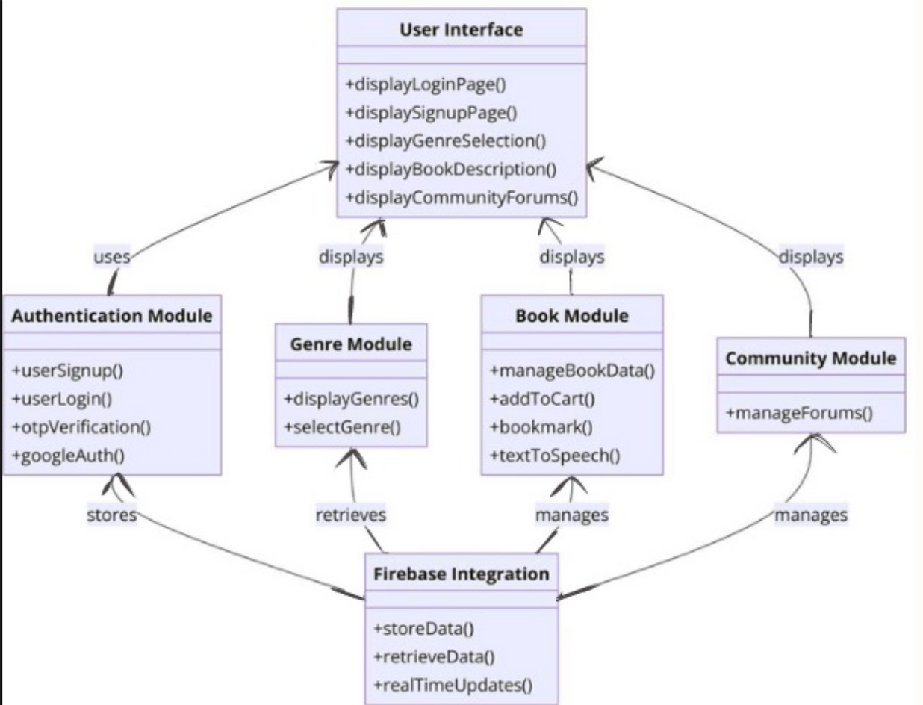
ARCHITECTURAL DESIGN
Structural Model

Slide 9
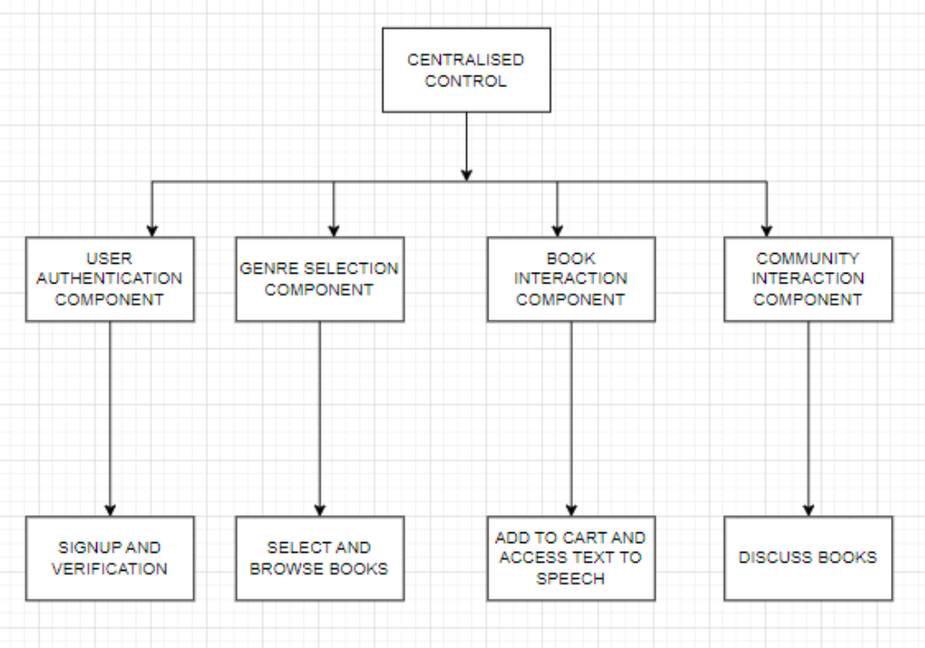
ARCHITECTURAL DESIGN
Control Model

Slide 10
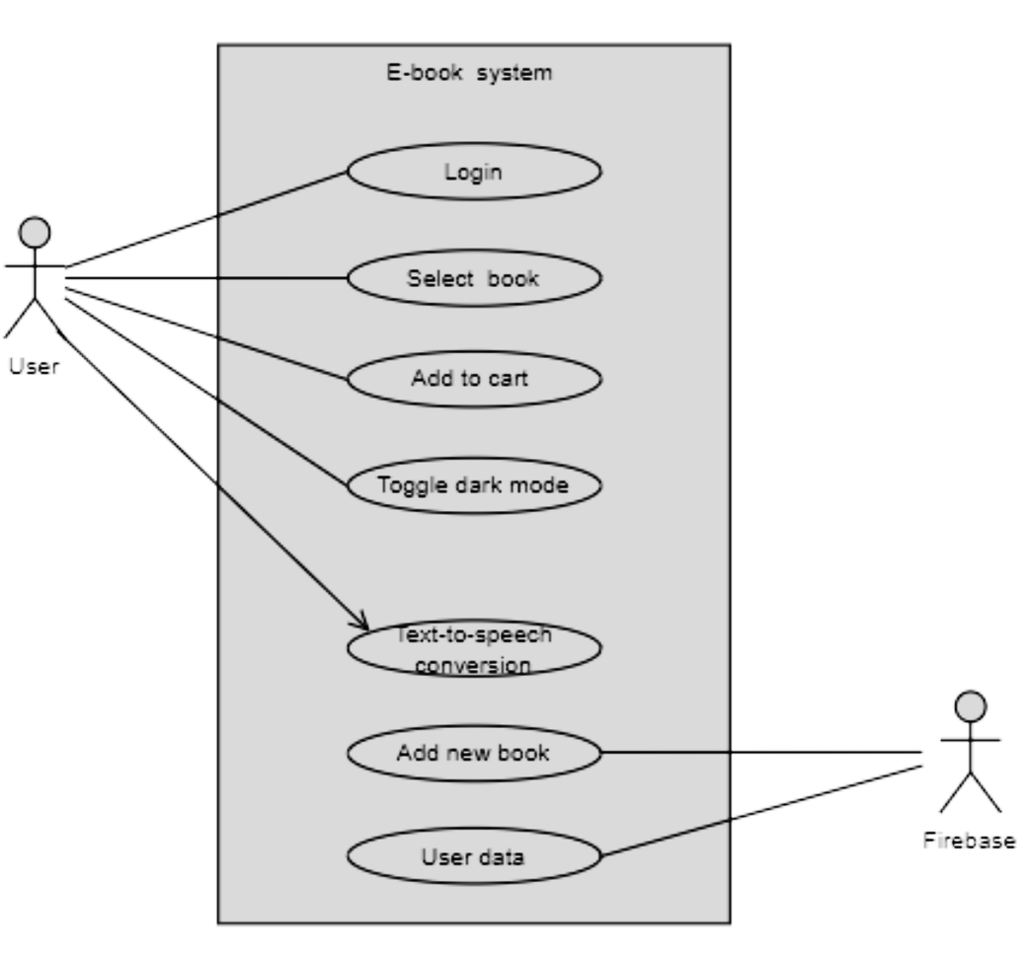
DETAILED DESCRIPTION OF MODULES
Usecase Diagram

Slide 11
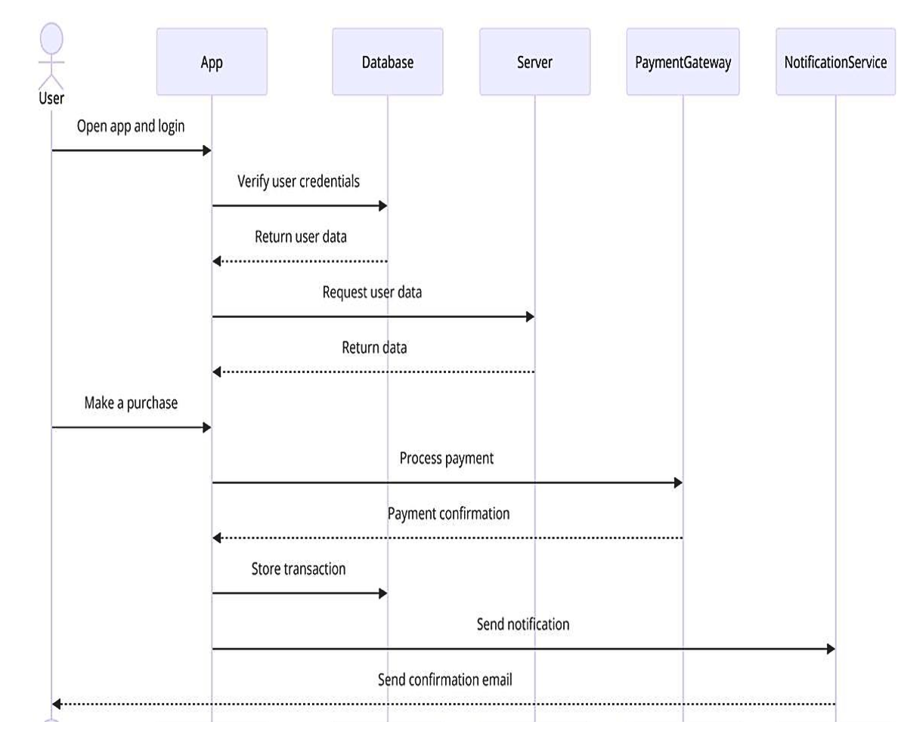
DETAILED DESCRIPTION OF MODULES
Sequence Diagram

Slide 12
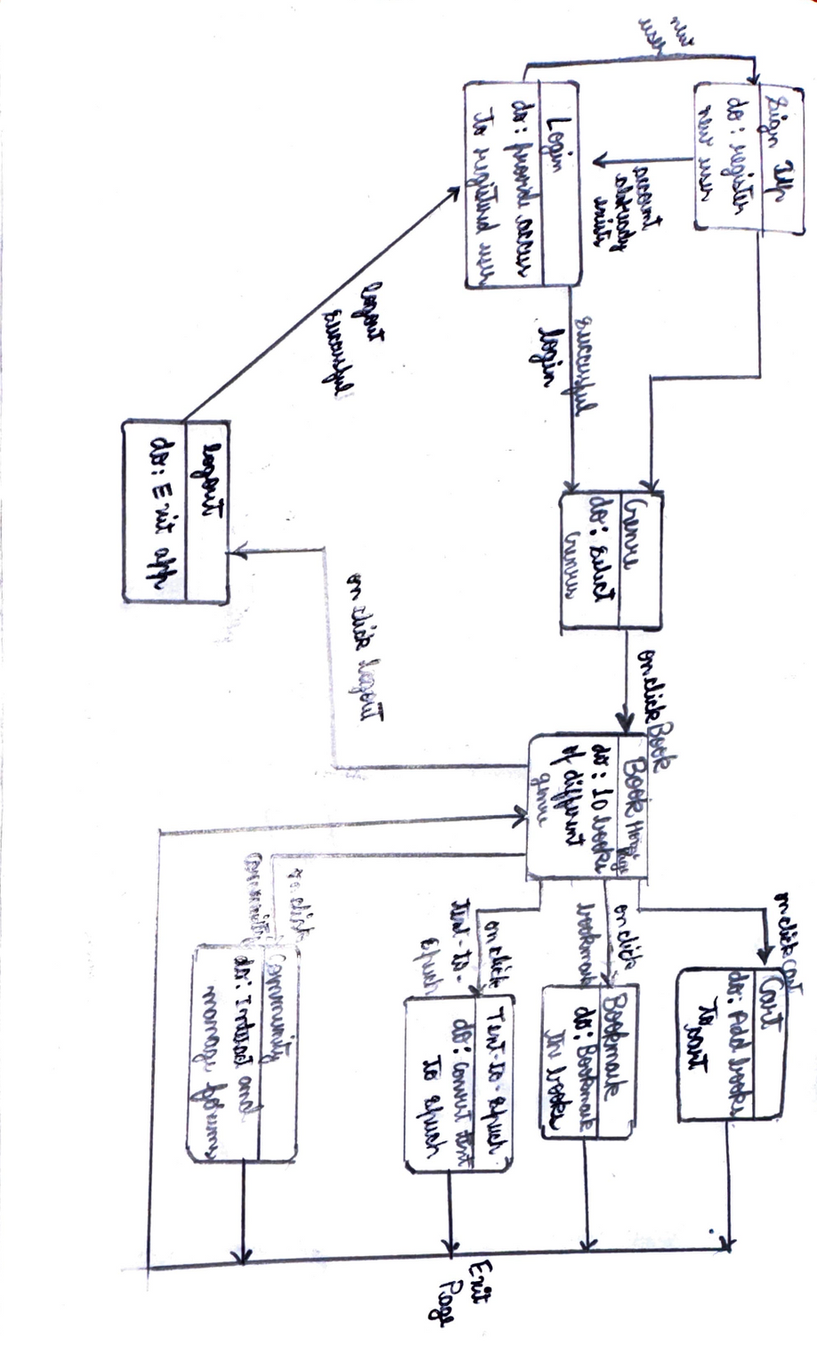
DETAILED DESCRIPTION OF MODULES
State Diagram

Slide 13
ESTIMATION AND SCHEDULE
Cost and Effort Estimation:
For the "Flip E-Book” app project, we have conducted a cost and effort
estimation using the Lines of Code (LOC) method. Below are the detailed
calculations and results.
Total LOC (S) = 4000 LOC
Average Productivity = 900 LOC/month
Labour Rate = ₹90,000/month
Step 1: Calculate Cost per LOC
Cost per LOC = Labour Rate per Month / Average Productivity
Cost per LOC = ₹90,000 / 900 ≈ ₹100

Slide 14
ESTIMATION AND SCHEDULE
Step 2: Calculate Total Cost of the Project
Total Cost = Total LOC * Cost per LOC
Total Cost = 4000 * 100 ≈ ₹400,000
Step 3: Calculate Effort in Person-Months
Effort in Person-Months = Total LOC / Average Productivity
Effort in Person-Months = 4000 / 900 ≈ 4.44
Rounded up to the nearest whole number:
Effort in Person-Months = 5
Summary:
Total Cost of the Project: Approximately ₹400,000
Effort in Person-Months: 5 Person-Months
This estimation provides a clear overview of the financial and time commitments
necessary for the " Flip E-Book " app project, allowing for effective
planning and resource allocation.

Slide 15
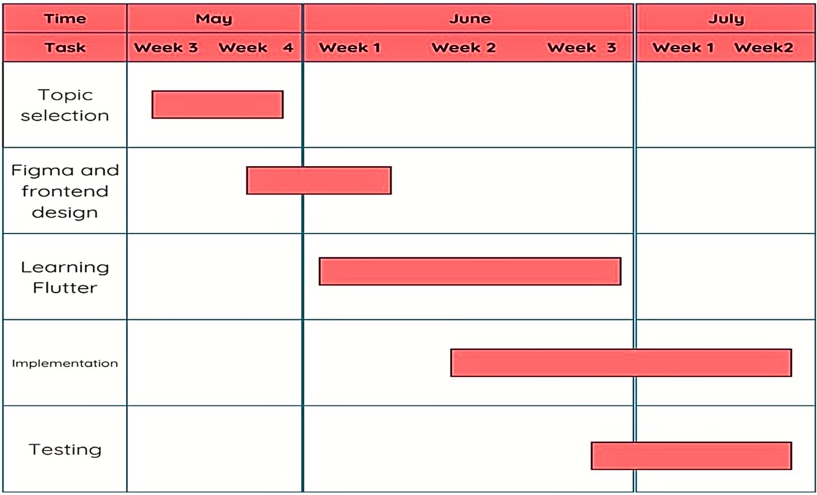
TIME LINE CHART

Slide 16
TEST CASES
User Registration
1. Test Case ID: TC_REG_001
Description: Verify that a user can successfully register with valid details.
Test Steps:
1. Launch the mobile app.
2. Navigate to the registration screen.
3. Enter valid user details (name, email, phone number, password).
4. Tap on the 'Register' button.
Login/Logout
2. Test Case ID: TC_LOGIN_001
Description: Verify that a user can successfully log in with valid credentials.
Test Steps:
1. Launch the mobile app.
2. Navigate to the login screen.
3. Enter a valid email and password.
4. Tap on the 'Login' button.
Expected Result:
● User should be logged in successfully and redirected to the home screen of the app.

Slide 17
TEST CASES
Genre Selection
3. Test Case ID: TC_GENRE_001
Description: Verify that users can successfully view books based on selected genre.
Test Steps:
1. Launch the mobile app.
2. Navigate to the genre selection screen.
3. Select a genre (e.g., travel, horror).
4. View the displayed books.
Book Description and Interaction
4. Test Case ID: TC_BOOK_001
Description: Verify that the book description is displayed correctly when a book is selected.
Test Steps:
1. Launch the mobile app.
2. Navigate to the genre selection screen.
3. Select a genre and then a specific book.
4. View the book description.

Slide 18
TEST CASES
Additional Considerations
1. Edge Cases:
• Verify behavior when special characters are used in the username, email, and
password fields.
• Test registration and login with maximum character limits for username, email, and
password fields.
• Check behavior when uploading large ebook files or files with uncommon formats.
2. Negative Testing:
• Test login with a non-registered email and any password.
• Attempt to upload unsupported file formats or corrupted ebook files.
• Simulate failed download attempts for ebooks.
3. Usability Testing:
• Check the responsiveness and ease of navigation on different devices and screen
sizes. Assess the usability of the app’s search functionality .
• Evaluate the ebook reader interface for accessibility features such as font size
adjustment, night mode, and text-to-speech.

Slide 19
CONCLUSION
In conclusion, Flip is an innovative e-book application designed to enhance the reading
experience through user-friendly features and robust functionality. By integrating seamless user authentication, genre-based browsing, detailed book descriptions, bookmarking, and
text-to-speech capabilities, Flip offers a comprehensive platform for e-book enthusiasts.
The inclusion of a community forum fosters engagement and discussion among users, while the
option for dark mode caters to user preferences for comfortable reading. The detailed
architectural design and thorough testing ensure reliability, security, and performance, making
Flip a dependable and enjoyable application for all users.
This report outlines the essential components and requirements for the successful implementation of Flip, providing a clear roadmap for development and deployment. As the e-book market continues to grow,
Flip is well-positioned to meet the evolving needs of readers, offering a modern, interactive, and engaging platform for digital reading.

